Slide 1




Succession to Value™ methodology
/DEFINE
/ASSESS
/MOBILIZE
/DEFINE
/ASSESS
/MOBILIZE
What needs to be true in the future for the role to succeed?
Are successors ready for the job? How ready are they?
How do we prepare and support the successor?
Outputs:
Future Jobs to be Done
Risk Assessment
Superpowers
Outputs:
Multi-point Evidence Mosaic
Readiness Summary
Pipeline Health Snapshot
Outputs:
Development Plan
Notes:
Swap icons w/16

Slide 2
Example – what does good look like
/DEFINE
/ASSESS
/MOBILIZE
Role: Head of Digital Solutions & Data
# | Wt% | Outcome | Priority Work
1 | 30% | Continuous Improvement of Infrastructure | What: Strengthen digital/data infrastructure so SuperApps, payments, and vertical platforms run reliably across five markets. How: Modernize Tier‑1 stacks; deploy SRE/AIOps, SIEM/SOAR, and standardized incident/change playbooks; enforce data residency, payments, and privacy controls; automate capacity and release validation. How much: Full compliance on audited systems; reduce unplanned downtime by 50%. By when: 31 Dec 2027.
2 | 35% | Digital Transformation of Core Processes | What: Reengineer core workflows (onboarding, payments, merchant/agent networks, clinical flows) to remove manual handoffs and speed delivery. How: Implement API-first, event-driven integrations, RPA for repeatable tasks, standardized data contracts, and automated reconciliation and observability. How much: $100M+ efficiency gains; digitize ≥70% of critical workflows. By when: 31 Dec 2028.
3 | 15% | Digital Innovation for New Products, Services, and Revenue Streams | What: Productize AI1440 and data capabilities into revenue-generating products across fintech, entertainment, healthcare, and education. How: Co-design with vertical and country teams, build compliant MLOps and data pipelines, localize LLMs, and scale pilots through product management and measurable monetization metrics. How much: Enable $50M+ new revenue; launch ≥10 products. By when: Revenue by 31 Dec 2028; launches by 31 Dec 2029.
4 | 20% | Major Platform & Technology Upgrade | What: Deliver major platform upgrades (SuperApp core, payments hub, identity, health stores) without disrupting customers or compliance. How: Use phased migrations, canary releases, validation testing, and disciplined change governance balancing central standards and local needs. How much: Complete 3 major upgrades with ≥95% on-time/on-budget delivery and <5% transition disruption. By when: 31 Dec 2028.
Ensure SuperApps, payments, and vertical platforms run reliably across five markets by strengthening digital and data infrastructure. Modernize Tier‑1 stacks and deploy SRE/AIOps, SIEM/SOAR, and standardized incident/change playbooks while enforcing data residency, payments, and privacy controls and automating capacity and release validation. Achieve full compliance on audited systems and reduce unplanned downtime by 50% by 31 Dec 2027.
Reengineer core workflows—onboarding, payments, merchant/agent networks, and clinical flows—to remove manual handoffs and accelerate delivery. Implement API-first, event-driven integrations, RPA for repeatable tasks, standardized data contracts, and automated reconciliation and observability to drive change. Deliver $100M+ in efficiency gains and digitize ≥70% of critical workflows by 31 Dec 2028.
Productize AI1440 and data capabilities into revenue-generating products across fintech, entertainment, healthcare, and education by co-designing with vertical and country teams, building compliant MLOps and data pipelines, localizing LLMs, and scaling pilots through product management and monetization metrics. Enable $50M+ of new revenue and launch ≥10 products, with revenue by 31 Dec 2028 and launches by 31 Dec 2029.
Deliver major platform upgrades (SuperApp core, payments hub, identity, health stores) without disrupting customers or compliance by using phased migrations, canary releases, validation testing, and disciplined change governance that balances central standards with local needs. Complete 3 major upgrades with ≥95% on-time/on-budget delivery and <5% transition disruption by 31 Dec 2028.

Slide 3
Execution risks
/DEFINE
/ASSESS
/MOBILIZE
WORK
ROLE
TALENT
Alignment: Is there alignment across stakeholders on the JTBDs?
Authority: Does the role have appropriate decision rights to deliver the JTBDs?
JTBD Match: Is there a strong match of skills and experiences to do the JTBDs?
Complexity: Is this an exceptionally complex task to deliver?
Capacity: Are there adequate resources / team capabilities to deliver the JTBDs?
Superpower Match: How well matched is the talent to the
identified superpowers?
New Work: Is the work new to the role, team, or organization?
Resistance: Does the role face any internal or external resistance to deliver the JTBDs?
Winning Track Record: Does the person have a consistent track record of persisting and finding a way to win?
Competitive Intensity: Is there significant external competitive pressure that impacts delivery?
Incentives: Are the incentives appropriately aligned to the scope of the work expected to deliver?
Two-Way Fit: Is there alignment between the individual and org culture, operating environment?
Notes:
Animate one column @ a time (on click)

Slide 4




Executive Development Pathways: The Three Buckets
Candidate
1. Role Change for Critical Growth
2. Stretch Assignments in Current Role
Behavioral & Capability Development
Candidate is ready for—or needs—a fundamentally different role to develop critical skills (e.g., new international, functional, or staff/influence experiences)
Candidate can build required capabilities or gain broader exposure through cross-functional projects, special initiatives, or enterprise task forces while staying in their present position
Candidate’s growth areas are best addressed through personalized coaching, feedback, and tailored leadership approaches—achievable within current or future roles

Slide 5
Development Action “menu”
Pathway | Potential Actions to Consider
Role Change for Critical Growth | New assignment (international, new business, transformation, enterprise, or staff role) Rotational program
Stretch Assignments in Current Role | Lead/participate cross-functional/enterprise task force Project sponsorship of critical internal/external facing initiative Peer swap on one area/scope of responsibility Board/LT meeting participation
Behavioral & Capability Development | Executive coaching 360 feedback Outside-function mentor for skill-building or org navigation External mentor with specific and relevant expertise Reverse/peer mentoring for specific capabilities Structured Peer Learning Networks Outside Board membership/shadow boards/Young Advisory Councils

Slide 6

From JTBDs to Success Enabling Plans
Define JTBDs
Outcomes
What are the 3-5 objectives which the work must accomplish to deliver value?
Pivotal Work
How will the role accomplish the outcomes?
Measures & Timing
How much?
By when?
Assess Execution Risks in Work and Role
Which JTBD would be the toughest to execute and deliver?
Is there a significant alignment gap or lack of clarity among stakeholders?
Does the role have “enough” decision rights to deliver the Jobs to Be Done?
Which JTBD will be impacted due to a lack of resources or its teams/org capability?
Define Superpowers
What are the things that the talent needs to be exceptional at to overcome the work and role risks?
Assess Talent Readiness and Role Talent Match
What is the readiness of the talent to deliver the JTBDs?
What is the willingness/motivation of the talent to deliver this work?
Identify the 2-3 Execution Risks that are the biggest drags
What are we solving for?
Which of the identified execution risks can be mitigated?
What should be prioritized?
Build targeted Success Enabling Plan
Talent, Org, and Role Centric, ensuring inclusion of actions outside the incumbent
Get alignment and commitment on the plans

Slide 7
VP Sales, Category A US
Jobs to Be Done
JTBD 1
Expand into new verticals to move from a restaurant brand to an “everywhere” brand
Outcome: From 75% restaurant business today to 50/50 split in 3 years, and 25% QSR / 75% FSR/NC in 10 years
Expand from a QSR only focus to build capabilities in FSR and Non-Commercial business (e.g. Aramark, Sodexo, Hospitals, Universities, Military)
30%
JTBD 2
Innovation: launch, implement and execute across the market
Outcome: Increase innovation as a % of total sales from 0.5% today to 5% in 3 years by ensuring that the Category A team
Rebuilds the muscle for innovation execution and strategic alignment with customers
Expand points of distribution in time to launch innovation
15%
JTBD 3
Win the Street
Outcome: Regain lost share in independents (2 points)
Create strong street share plans with national distributors (strong JBPs with large, multi-national customers, e.g, Sysco)
Work on PPA with revenue management and marketing teams
Build relationships with brokers (135); ensure execution of plan
20%
JTBD 4
Scale with North American customers globally
Outcome: Double our business across 6 global customers from $500M to to $1 billion globally
Lead the customer relationships in NA and build JBP’s for customer expansion globally
Ensure internal alignment with markets outside the US to serve the customers seamlessly
15%
JTBD 4
Build fit-for-purpose talent and capabilities for Category A in the sales teams to deliver high growth plans
More feet on the street to deliver incremental $1.2 billion NSV
With new capabilities to launch and execute innovations as well as serve growth in FSR’s and non-commercial businesses
Deliver capability for growth in both internal teams and in broker organizations
20%
Superpowers
SP1
Proven ability to deliver a food service business in a multi stakeholder, matrixed environment where you must drive collaboration at pace without positional authority.
SP2
Exceptional track record of building organizational capability to future proof a business

Slide 8
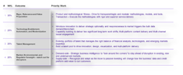
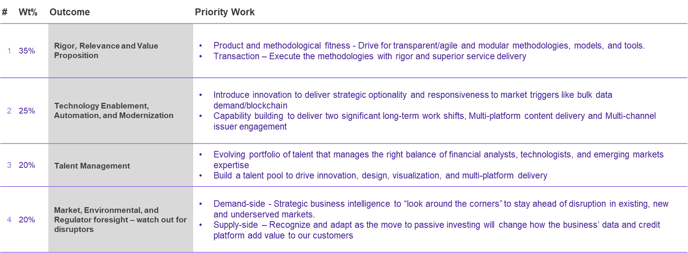
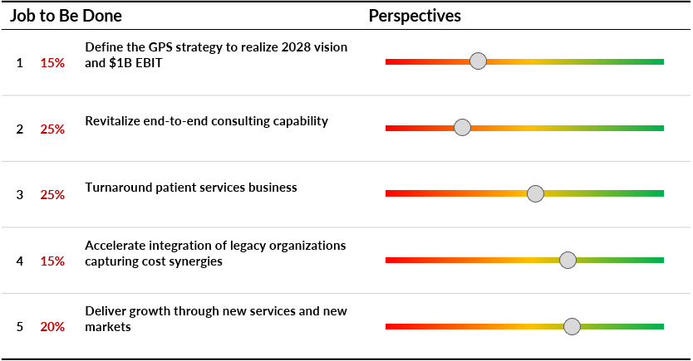
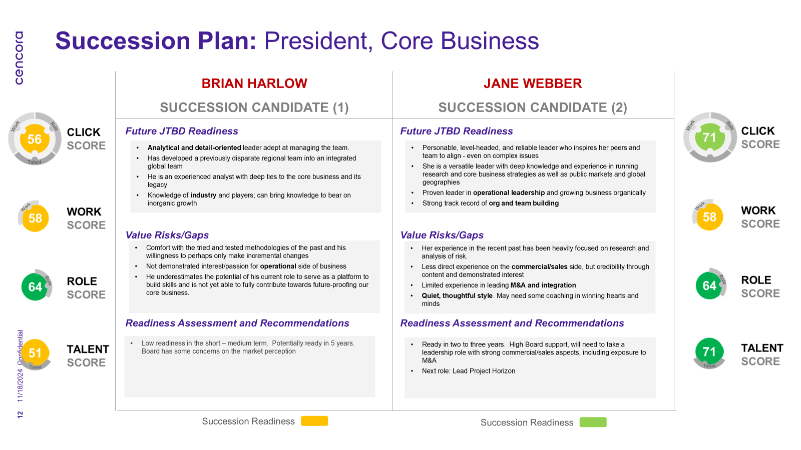
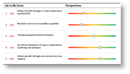
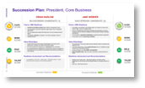
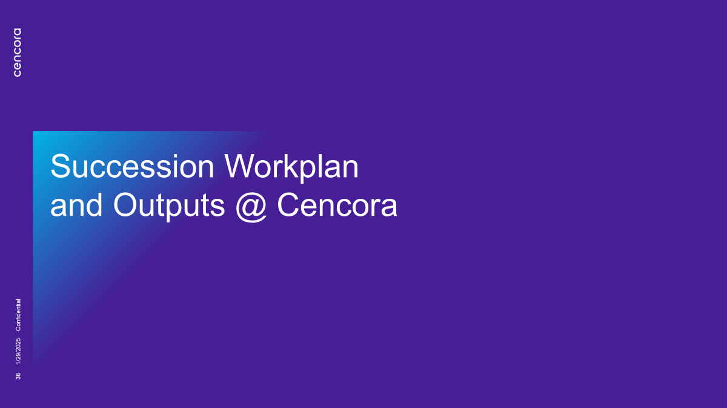
Evolving Succession Planning through Talent to Value
/List Critical Roles for Succession
/Click Succession Readiness
Enabling Succession Readiness
/Clicking Succession Readiness
Anchored in
Jobs to be Done
Externally Validated Assessment
Succession Mobilization Plans
Continuous Succession Readiness
Points of Departure

Slide 9
Strategic Pivots → Value Hotspots → Work Headlines
Illustrative
Branded generics |  | Product Innovation in chosen therapeutic areas
Emerging markets (unstable currencies) |  | Diversified global strategy with focus on US, W Europe & APAC
Incremental organic growth |  | Balanced organic and inorganic growth (M&A, partnerships, in-licensing)
Strategic Pivots
DRIVE GROUP EFFICIENCY
20%
MANUFACTURING OPTIMIZATION
15%
PRODUCT PORTFOLIO
20%
INORGANIC EXPANSION
25%
DIGITAL ADOPTION
10%
VALUE HOTSPOTS
Implement new Operating Model
Standardize and harmonize HR, Finance, IT, Procurement processes and create centralized Business Shared Services
Tax optimization by revising funds flow and profitability improvement
Embed robust change management to drive leadership alignment & manage resistance
Modernize & automate (machinery, robotics, process controls) facilities
Integrate sites & optimize operations (production scheduling, capacity planning, workflow management)
Enhance Supply Chain Resilience - procurement, logistics, inventory, & risk management
Align manufacturing priorities with strategic product launches
Turkey business transformation
Lifecycle mgmt. of existing products (reformulations, expansions, erosion defence)
Prune commoditized SKUs
Cross-selling brands
New Product Launches (oncology cardio-metabolic) - Identify untapped growth in underperforming markets
Build regulatory, supply chain, commercial, market access capabilities
Aggressive in-licensing and partnerships for innovation
Develop targeted entry for US, West Europe, APAC).
Pursue large-scale M&A (global pharma/innovator assets)
Focused inorganic growth for entry into high-growth/margin therapeutic areas
Acquisition of late-stage pipeline opportunities
Strengthen product development to accelerate commercialization
Develop advanced integration capabilities for post-merger synergy realization
Implement Core Digital Platforms
Embed digital, AI, automation across commercial, manufacturing, support functions for actionable, real-time data
Drive interoperability of digital systems & alignment of data standards
Optimize digital investments for unified, cloud-based systems that support enterprise-wide data, automation, and process visibility
WORK HEADLINES
ENABLERS 10%
TALENT MANAGEMENT &
ORG SIMPLIFICATION
RISK MANAGEMENT AND CYBERSECURITY
ESG, QUALITY & SUSTAINABILITY

Slide 10
Critical Roles @ Value Hotspots
Illustrative
Drive Group Efficiency
20%
Manufacturing Optimization 15%
Product Portfolio
20%
Inorganic Expansion
25%
Digital
Adoption
10%
Enablers
10%
$680M
$510M
$680M
$850M
$340M
$340M
CRITICAL ROLES @ EACH HOTSPOT
VP Transformation VP Tax VP Treasury VP Corporate Communications Head of Change Management Head of Processes (Shared Services)
SVP Corporate Supply Chain SVP Cluster Manufacturing Sr Dir Digital Mfg SVP Finance Mfg Head Mfg Turkey Head of Mfg
SVP Generics Portfolio Strategy, BD and Launches SVP Corporate Development VP Regulatory, Medical & Pharmacovigilance Head of Generics (5 regions) Head of Alliance Management Head of New Launches
SVP Corporate Development VP DD & Operations VP Corporate Legal Head of M&A Head of Post Merger Integration Head of Strategic Insights Head of New Markets
VP Digital & Innovation Sr Dir Digital Mfg Head of Digital Generics Head of IT Platform Integration Lead / Enterprise Architect Head of Digital CoE Head of Digital Adoption
Head of Cybersecurity SVP Corporate Quality Head of Integrity & Compliance Head of HR Due Diligence & OD Head of Risk Head of Environmental Sustainability VP HR CoEs
New Role

Slide 11
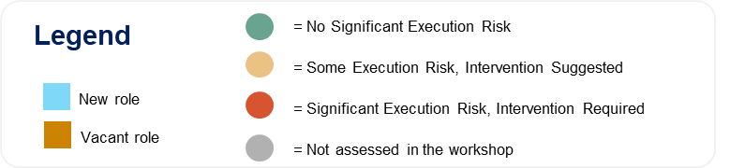
Human Capital Balance Sheet
Illustrative
Human Capital Insights
N-1 Roles Not Included
Role & Talent risks
Currently role risk is moderate for roles assessed - 7 were rated red / amber with 13 / 30 roles not assessed.
Overall, strong talent for roles assessed, with moderate risks in ability to scale and succession
Succession planning is weak with roles rated “amber” due to lack of ready-now clear successor, especially in functional & regional roles.
New Roles
There are 6 new roles and 6 vacant positions out of the Top 30.
Most new roles are in change and post-merger integration.
There is misalignment and resistance in the newly defined roles at market / country level in supply chain.
Capabilities for Growth
Need for regulatory, supply chain, commercial and market access capabilities to support new launches and market entries
Current Digital/IT capabilities need ongoing development given criticality for building shared services and automating manufacturing.
Need to strengthen capabilities in organization change and post merger integration

Slide 12
Mobilization Plan
Illustrative
What Are the Big Bets?
Are the Stakeholders
Aligned?
1
Operating Model & Governance
Define Clear Decision Rights and Ways of Working at Key Interfaces (global Supply Chain, Portfolio Strategy, Bd & Launches).
Once the New Structure Is Stable (6–12 Months), Launch Zero Based Budgeting (zbb) to Reduce Duplication and Streamline Costs.
Design Medium-term Op. Model Roadmap to Consolidate Manufacturing & Regions with Future Roles Such as Head of Alliance Management, Head of New Launches, Head of New Markets, Head of Digital CoE, Head of Digital Adoption
Define Digital Mandate & Accelerate Change
Define next Evolution of Digital Strategy & Roadmap (beyond IT Foundations) and Get Board Endorsement.
Define Which Digital Roles Should Sit Centrally in CoE Vs. Which Roles Should Sit in the Businesses to Drive Adoption.
Change: Link the Change Agenda to Strategic Pivots (manufacturing, Shared Services, Digital).
2
Is the Top Leadership
team ready?
3
Enable N-1 roles
Create success enabling plans for N-1 roles (align on future jobs to be done, identify risks & define actions to mitigate execution risks)
Establish a quarterly session for the top team to rapidly resolve organization pain points & risks.
Do we have enough talent where it matters?
4
Prioritize hiring new & vacant critical roles
Phased Talent Acquisition: Finalize recruitment priorities for next 12 months, with an initial focus on Head Of Strategic Insights, VP Digital and Head of Change Management. ,
Onboarding for New Roles: Build clear onboarding plans for each new role with 4–5 Jobs To Be Done.
Succession Planning: Create a dedicated process for the 10 critical roles rated red/amber for succession planning

Slide 13


Insights: Five Common Value Hotspots across 10+ PortCos
ALIGNMENT OF LEADERSHIP TEAMS VARY ON VALUE HOTSPOTS
Operational excellence
& cost discipline
15%
Grow organically & product premiumization
50%
Digital, data & automation
10%
Programmatic M&A
& partnerships
15%
People 10%
Zero‑Based Budgeting
Standardize processes
Optimize supply‑chain/logistics
Optimize SG&A
Targeted Regional & Global Expansion
Higher‑margin product portfolio
Build commercial teams’ capabilities
Integrated ERP/cloud platforms
AI/analytics
Automate repetitive operations
Repeatable M&A playbook
JVs/bolt‑ons in target regions
Integrate acquisitions quickly
Succession plans
Talent Acquisition for N-1 roles
Performance incentives and retention levers
Simple Operating Model
Alignment exercise between Portfolio Manager, CEO and N-1 needed

